Slide 1
UOB Models Analytic Platform RFP Proof of Concept
July 2023

Slide 2
Data Virtualization
Functional Criteria # | Technical Criteria #
A1.1A.2 (Can the system manage metadata and lineage as data gets transformed?) | B1.3.2 (Ability to integrate with source data without requiring significant ETL work by developers. Please elaborate scenarios where development work is required for data ingestion into the platform)
A1.1A.7 (enforce or inherit data security and entitlement implemented by data source) | B1.3.6 (run customized queries to get data from the data sources)
A1.1A.8 (build data security and entitlement layer in the absence of such from the data source) | B1.3.7 (Ability to Support Federated/Unified Query to access the data from multiple data sources like DB2, Hive or Teradata)
 | B1.3.11 (query multiple data sources at the same time when designing a strategy/policy (design time)
 | B1.3.12 (query multiple data sources at the same time when executing a strategy/policy (run time)

Slide 3
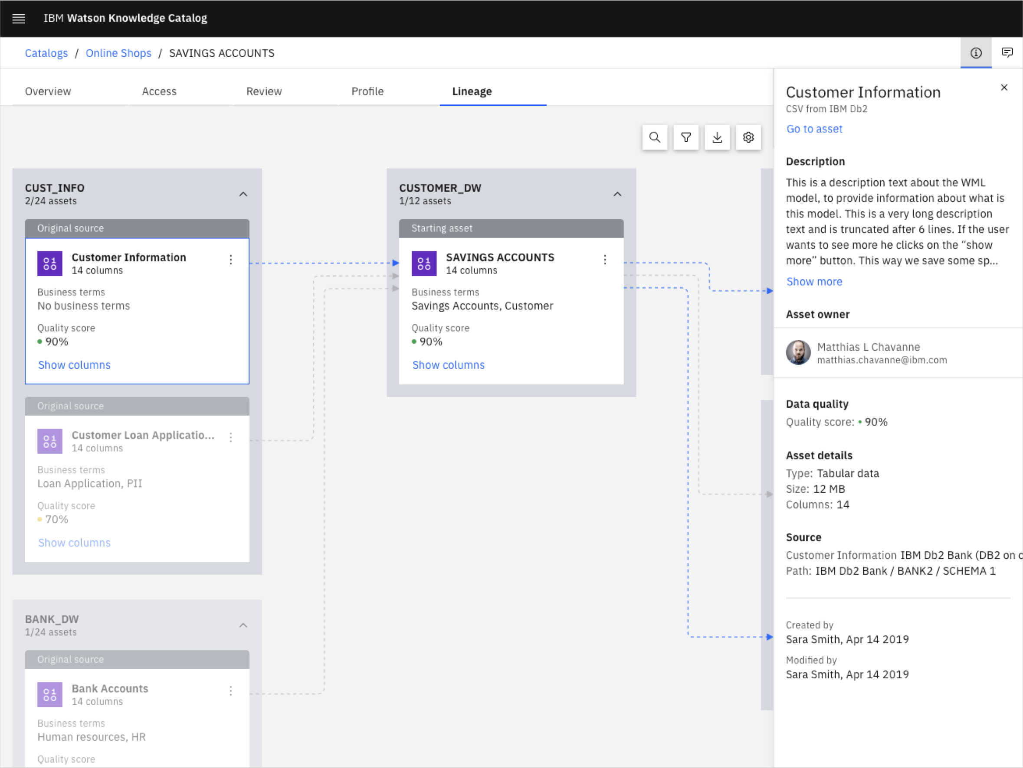
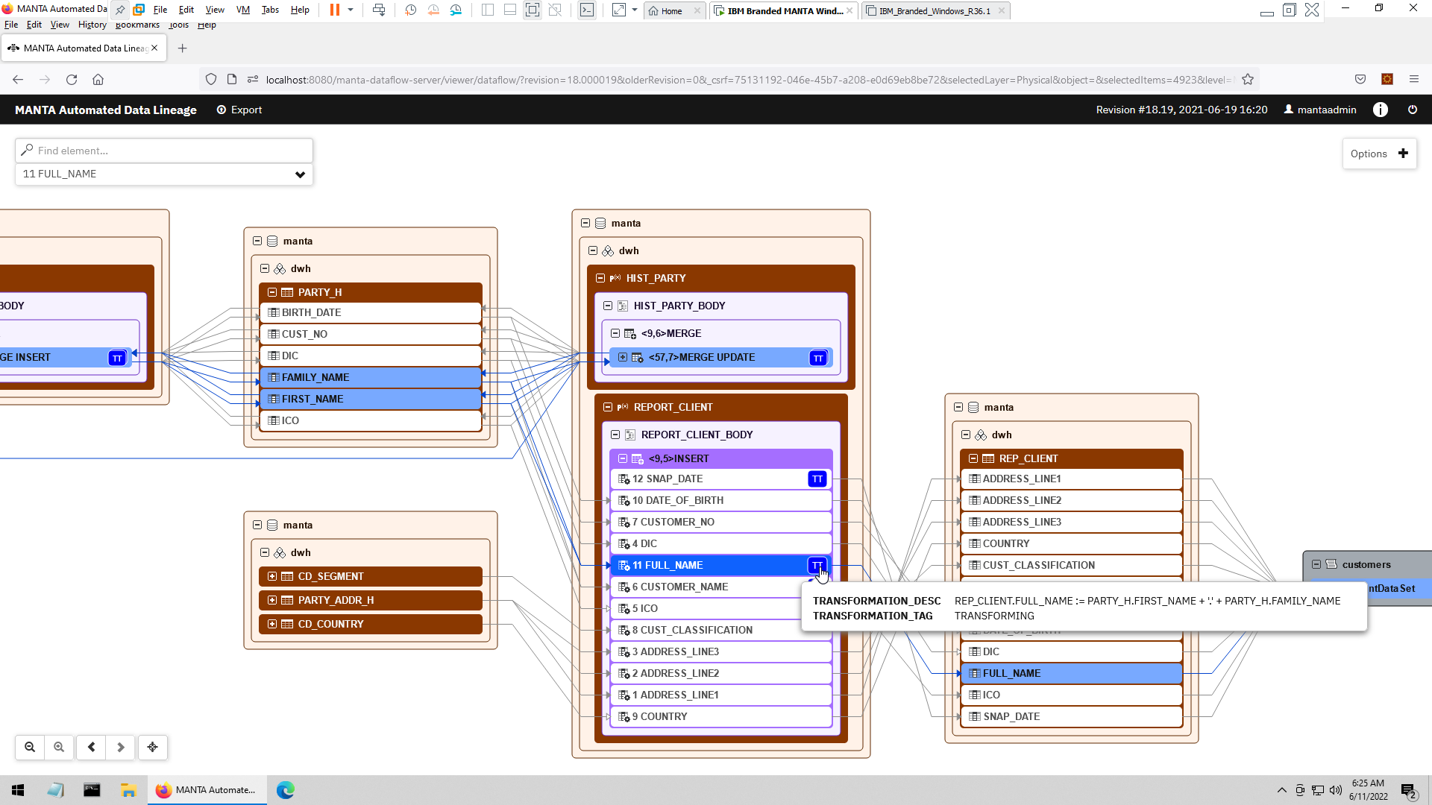
A1.1A.2: Data Lineage
Provides business-user-friendly summary view
Drill down to view technical details
Automated discovery of data flows from 3rd party tools
Code analysis of stored procedures & ETL jobs capture transformations
Manual lineage through APIs
Technical, Indirect, and Historical data lineage GUI
Rules to filter for things needed in data lineage
© 2022 IBM Corporation
3

Slide 4
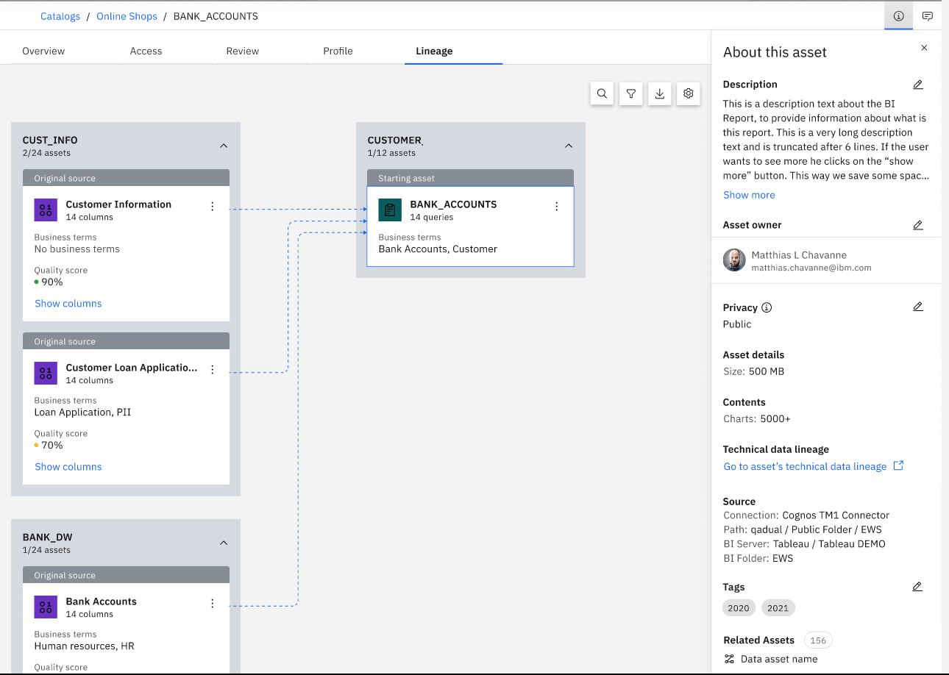
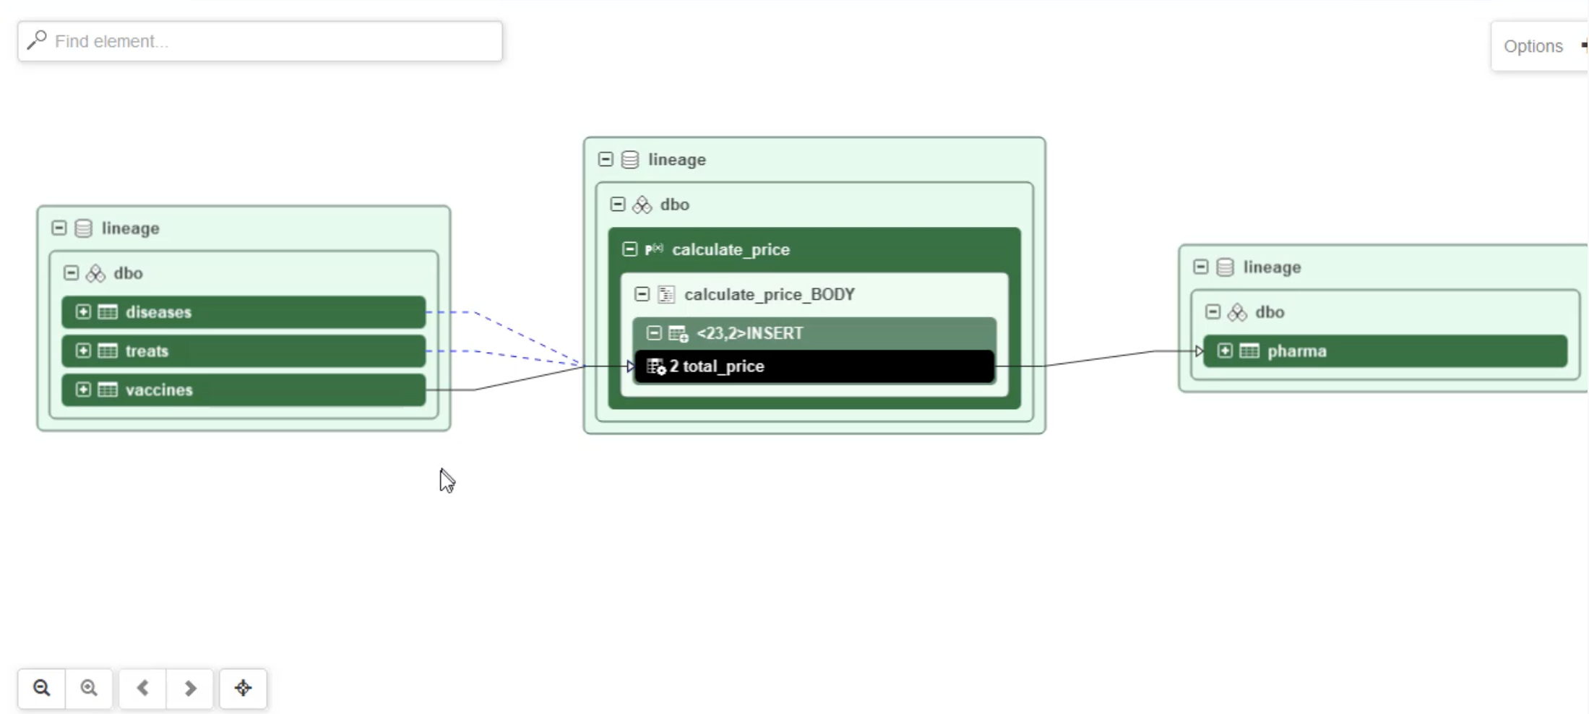
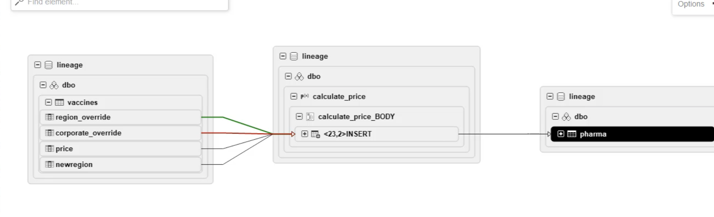
A1.1A.2 : Manta Automated Data Lineage
CPD data lineage
MANTA Automated Data Lineage Add-On
Automated discovery of data flows from 3rd party tools
Code analysis of stored procedures and ETL jobs to capture transformations
Advanced manual lineage
Technical data lineage GUI
Indirect data lineage
Historical data lineage
Rules to filter for things needed in data lineage
1
2
Scanned assets are stored in WKC catalogs and visible through native UI
Technical data lineage
3
Option to view additional lineage details
CPD Data Lineage
View lineage graph via WKC UI
REST APIs to capture lineage info
Import/export lineage through CSV
Automatically captures data flows from the CP4D platform
Models from Auto AI
Data Virtualization
Next Gen DataStage Jobs
Data Refinery
Advanced Data Privacy
Historical data lineage
© 2022 IBM Corporation
4

Slide 5
Supported Scanners
Databases
Yellowbrick
Amazon RDS for PostreSQL
Amazon Redshift
Amazon Aurora
Google Big Query
Snowflake
Greenplum
Hive (Apache)
IBM Db2
Microsoft Azure SQL Data Warehouse
Microsoft Azure SQL Managed Instance
Microsoft SQL Server Database
Netezza
PostgreSQL
SAP ASE (Sybase)
SAP Hana
Teradata Database
Oracle
Amazon S3
Data integration
Apache Kafka
Infosphere DataStage
Informatica Power Center
Microsoft SQL Server Integration Services
Oracle Data Integrator
Pig
Sqoop
StreamSets
Talend
Azure Data Factory
Next Gen Data Stage
Fivetran
DBT
Programming languages
COBOL
Note:
Scanners not on this list can be supported through either MANTA’s Advanced Manual Lineage or through IBM Business Data Lineage’s native Manual Lineage Capabilities
Reporting & Analysis
Qlik Sense
Cognos
Microsoft Excel
Microsoft SQL Analytics Platform System
Microsoft SQL Server Analysis Services
Microsoft SQL Server Reporting Services
Oracle Business Intelligence (OBIEE)
Power BI
SAP Business Objects
SAS
Tableau
Modeling
ER/Studio
Erwin Data Modeler
SAP Power Designer
© 2023 IBM Corporation
5

Slide 6


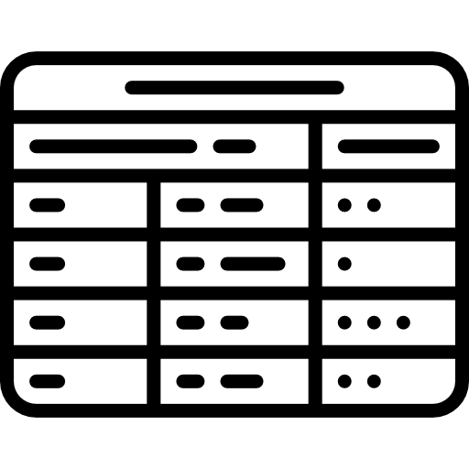
A1.1A.7, A1.1A.8, B1.3.7, B1.3.11 & B1.3.12: What is Data Virtualization
Data virtualization enables access to physical data from various sources, in a virtual manner, so that the data can be accessed, manipulated, and analyzed, without needing to know its physical format or location, and without having to move or copy it.
Connect, access, and govern any data without the need for data movement
Access structured and unstructured disparate data on demand, without the need for ETL or creation of copies.
Abstract complexity from data consumers
A virtual semantic layer across all your data sources allows users to quickly connect to, join, and analyze data from multiple sources without needing to understand back-end database technologies.
Create virtual views over multiple data sources
No need for transformations; create a virtual view of required data that can be shared within your organization.
Governance integration and security
Controlled, governed and secure access to virtual data sets through native integration with Watson Knowledge Catalog.
Appears as if all tables are in the same database
Virtual Tables represent the physical data
Physical Tables

Slide 7
A1.1A.7, A1.1A.8, B1.3.7, B1.3.11 & B1.3.12: What is IBM Watson Query
A universal data access layer that automates how you access and unify data across any source or type (clouds, warehouses, lakes, etc.) with data virtualization, without the need for data movement or replication
Watson Query Experience
Data Science
Business Intelligence
AI Apps
One query experience over multiple data sources, types, and form factors
Integrated governance with Watson Knowledge Catalog to provide governed data access
Open data formats to work with data on any cloud and on-premises (Parquet, Orc, CSV, TSV)
Real-time data integration without data movement
Intelligent cache recommendation accelerating query performance with minimal user input
Unified Ops
Self-Service
End-to-end Governance, Security, Compliance
IBM Watson Query
Virtual Tables
Connection Layer
Data Sources
COS
Blob Storage
Cloud Storge
S3
Db2
Netezza
Teradata
IBM Cloud
Cloudera
Azure
GCP
AWS
Snowflake
Oracle
… and more!
Cloud Data Lake
Database and Warehouse
Any Data, Anywhere.

Slide 8
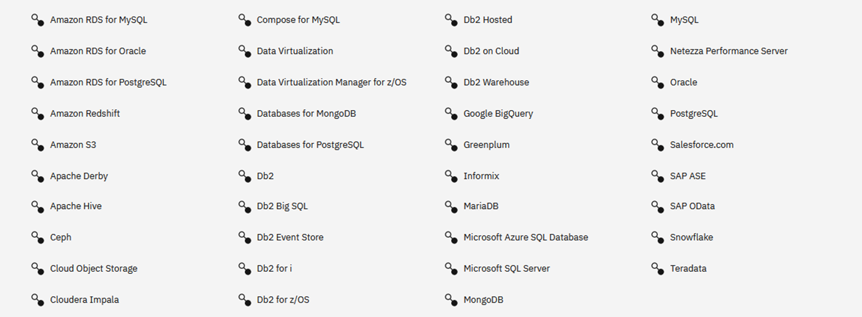
B1.3.7, B1.3.11 & B1.3.12 : Broad support for Data Sources
New sources continually added!

Slide 9
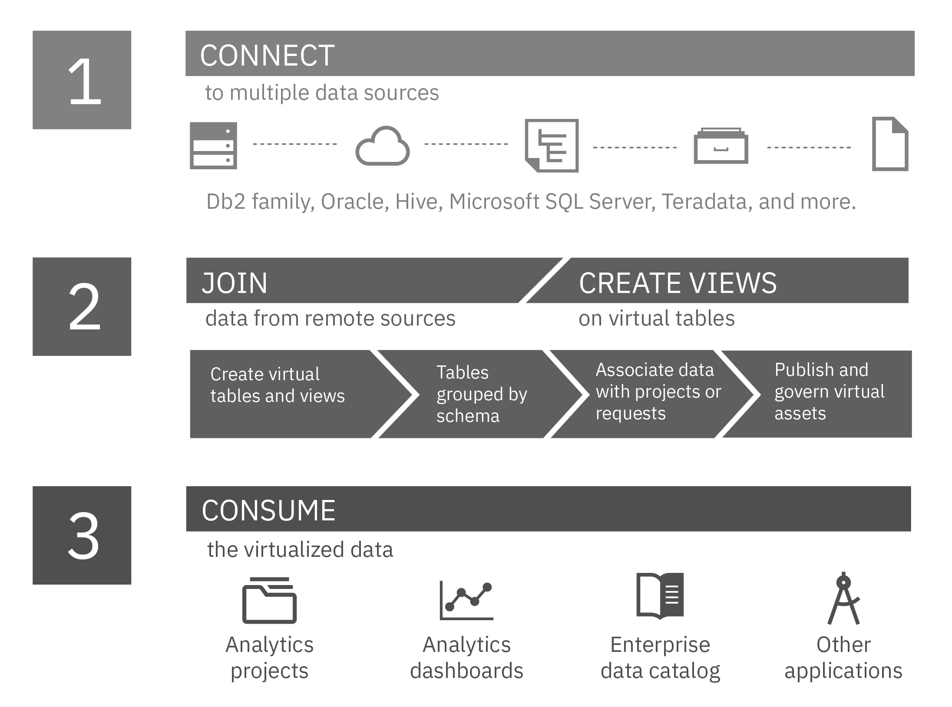
B1.3.3 About Watson Query
Size limits: Watson Query supports virtualization of tables with a row size up to 1 MB, and up to 2048 columns in a table. However, the number of columns that Watson Query can preview depends on many factors, such as the data types of the columns. Currently, preview is limited to 200 columns.
File formats: Watson Query supports PARQUET (or PARQUETFILE), ORC (optimized row columnar), CSV (comma-separated values), TSV (tab-separated values), and JSON file formats. Metadata is extracted from the data file.
For CSV and TSV files: Cloud Pak for Data automatically detects the encoding scheme of flat data files, such as CSV and TSV files.
https://www.ibm.com/docs/en/cloud-paks/cp-data/4.6.x?topic=connectors-setting-character-encoding-scheme

Slide 10
Data Virtualization
Functional Criteria # |  | Technical Criteria #
A1.1A.2 (Can the system manage metadata and lineage as data gets transformed?) |  | B1.3.2 (Ability to integrate with source data without requiring significant ETL work by developers. Please elaborate scenarios where development work is required for data ingestion into the platform)
A1.1A.7 (enforce or inherit data security and entitlement implemented by data source) |  | B1.3.6 (run customized queries to get data from the data sources)
A1.1A.8 (build data security and entitlement layer in the absence of such from the data source) |  | (B1.3.7) Ability to Support Federated/Unified Query to access the data from multiple data sources like DB2, Hive or Teradata
 |  | B1.3.11 (query multiple data sources at the same time when designing a strategy/policy (design time)
 |  | B1.3.12 (query multiple data sources at the same time when executing a strategy/policy (run time)

